Slide 1

BASIC PRINCIPLES OF PROJECT MANAGEMENT
Prof. Nguyen Van Hung
9/2020

Slide 2



Slide 3
I. Overview of the course
Module aim
Expected outcome
Content of the course
Assessment

Slide 4
1. Module aim
Introduction to students about the definition of Projects , Classification of Projects and Project notables examples
Familiarize students with legal language; basic concepts, principles and basic knowledge of the Project , Project Management
Introduction to students about research scientific projects : Basic Research and Applied Research Projects
Expose students to legal reasoning and develop their ability to apply legal concepts in the Research fields
This course helps students to improve skills of managing a project such as leadership skills, team building, conflict management ,time management …

Slide 5
2. Expected outcomes
After completing the course, students should have:
Basic knowledge on Project : What is a Project , Project Classification and Project Management Basics
Basic knowledge of Project Management ; from initiating ,designing ,selecting project manager, implementing, time management ,controlling and finishing the Project .
Basic knowledge on Scientific Research Project :
- Basic Scientific Research Project
- Applied Scientific Research Project ; Analyzing and problem-solving skills to be applied to practical cases .

Slide 6
3. Content of the course
Lecture 1 - PART I : PROJECT
Overview of the course
Introduction into Project
- Classification of Projects
- Overview of some notable examples for Projects
  Lecture 2 – PART II -PROJECT MANAGEMENT BASICS
  Chapter 1 : Values ; Needs ; Phases of Project management and the Steps in Managing a project
  Lecture 3 –
  Chapter 2- Project Management Basics ( continued)
  Manager , Organization and the TEAM in Project Management
  -lecture 4 –
  Chapter 3 – Project Management Basics ( continued )
  Project Planning ; Project Scheduling ; Project Monitoring ;Project Controlling ;Project Evaluating and Termination
  Lecture 5 – PART III - RESEARCH PROJJECT
  Types and Kinds of Research Projects
  Types of Research Scientific Projects
  Notable Examples for Research Scientific Projects

Slide 7
4. Assessment
60%
30%
10%
100%
Final Exam :
Midterm Test (4/20 )
Attendance (2/20 )
Total (20/20 )

Slide 8
Refferences And Reading list
1. Sdudent Worbook- Fundamentals OF Management ; First edition_1998
2. James P.lewis –Fundamentals of Project Management ; Third edition_2007 .
3- Joseph Heagney – Fundamentals of Project Management ; Fourth edition_2005
4. Project Management Institute- A Guide to Project Management Body of Knowledge (PMBORGuide ); Fifth edition_2013
5. Russ Unger and Carolyn Chandler’s- A project Guide to UX Design : For User Experience Designers in the Field or in the Maketing ; Second edition_2009
6.Project Management : Project Evaluation & Termination
https:iesgeneralstudies.com/material-science-chapter-5 .

Slide 9
Lecture 1
PART I : PROJECT
- Introduction into Projects
- Definition , Classification of Projects
- Overview of some notable examples of Projects

Slide 10
PART I
INTRODUCTION INTO PROJECTS

Slide 11
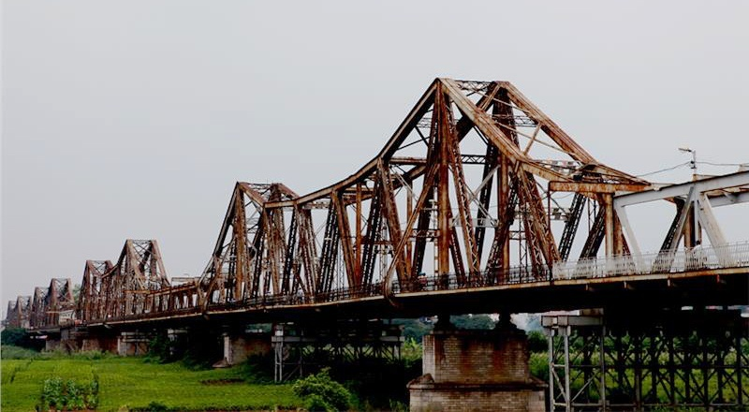

I. OVERVIEW OF PROJECT
Historical Projects:
Construction of Longbien Bridge
Tour Eiffel
The bridge was built in 1899–1902 by the architects Daydé & Pillé of Paris, and opened in 1903. Before North Vietnam's independence in 1954, it was called Paul-Doumer Bridge, named after Paul Doumer - The Governor-General of French Indochina and then French president. At 1.68 kilometres (1.04 mi) in length, it was, at that time, one of the longest bridges in Asia.

Slide 12
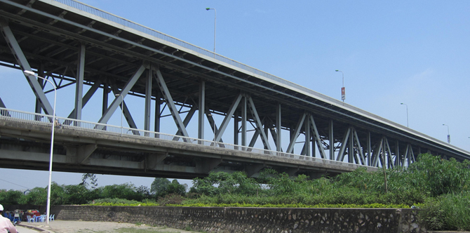
Thang Long Bridge
The bridge was built in 1974–1985, is a bridge in Hanoi, Vietnam, which connects the city with Noi Bai Airport. At 3.25 kilometres in length.

Slide 13
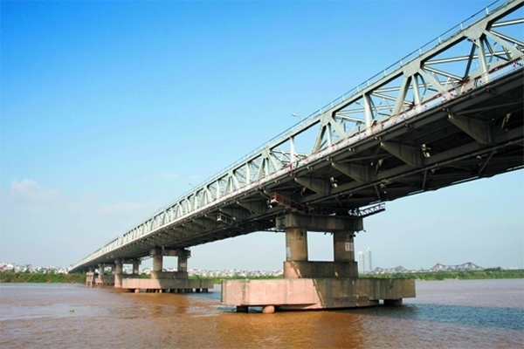
Chuong Duong Bridge
The bridge was built in 1983–1985, is a major river road bridge in Hanoi. At 1.23 kilometres in length.

Slide 14
1. Origin and Etymology of project
The word project comes from the Latin word projectum from the Latin verb proicere, "before an action" which in turn comes from pro-, which denotes precedence, something that comes before something else in time (paralleling the Greek πρό) and iacere, "to do". The word "project" thus originally meant "before an action".
When the English language initially adopted the word, it referred to a plan of something, not to the act of actually carrying this plan out. Something performed in accordance with a project became known as an "object". Every project has certain phases of development.
2. Project synonyms
2.1. Synonyms
Arrangement, blueprint, design, game, game plan, ground plan, master plan, program, plan, road map, scheme, strategy, system.
2.2. Related words
Collusion, conspiracy, plot; contrivance, device, gambit, maneuver, ruse, stratagem, subterfuge,trick; counterplan, counterstrategy; means, tactic, technique, way; procedure, protocol; conception, idea , proposal, specific (s), specification(s); aim, intent, intention, purpose; diagram, formula, layout, map, pattern, platform, policy, recipe, setup.

Slide 15
3. Definitions of project
There are various definitions of project from different sources:
3.1. “A project is a temporary endeavor undertaken to create a unique product, service, or result.”
Project Management Institute (PMI) - A Guide To The Project Management Body Of Knowledge (PMBOK Guide) Fourth Edition 3.
3.2. “A project is a temporary organization that is created for the purpose of delivering one or more business products according to an agreed Business Case.”
Office of Government Commerce (OGC) - Managing Successful Projects with PRINCE Fifth Edition 4.
3.3. “A project is a time and cost constrained operation to realize a set of defined deliverables (the scope to fulfil the projects objectives) up to quality standards and requirements.” International Project Management Association (IPMA) - IPMA Competence Baseline (ICB) Version 3.05.
3.4. “Project is a unique, transient endeavour undertaken to achieve a desired outcome.” Association for Project Management (APM) - APM Body of Knowledge Fifth Edition 6.
3.5. “A project refers to a value creation undertaking based on a specific, which is completed in a given or agreed time frame and under constraints, including resources and external circumstances.”
Project Management Association of Japan (PMAJ) - A Guidebook of Project & Program Management for Enterprise Innovations (P2M) 2005 Edition 7.

Slide 16
3. Definitions of project
There are various definitions of project from different sources:
3.6. “Project is a unique process consisting of aset of coordinated and controlled activities with start and finish dates, undertaken to achieve an objective conforming to specific requirements including constraintsof time, cost and resources.”
ISO 10006:2003 - Quality Management Systems - Guidelines for Quality Management in Projects 8.
3.7. “Project is a unique set of coordinated Activities, with defined starting and finishing points, undertaken by an individual or organization to meet specific objectives with defined schedule, cost and performance parameters.”
British Standards Institute: BS 6079-1: Guide to Project Management 9.
3.8. “A project is a temporary endeavour undertaken to create a unique product, service or result in order to achieve an outcome.”
Australian Institute of Project Management (AIPM): AIPM Professional Competency Standards for Project Management 2008 Edition 10.
3.9. “A project is a managed set of interrelated resources that delivers one or more products to a customer or end user. The set of resources has a definite beginning and end and operates according to a plan.”
Software Engineering Institute (SEI): Capability Maturity Model Integration (CMMI) 12.
3.10. “A project is a managed set of interrelated resources that delivers one or more products to a customer or end user. The set of resources has a definite beginning and end and operates according to a plan.”
Software Engineering Institute (SEI): Capability Maturity Model Integration (CMMI) 13.

Slide 17
3. Definitions of project
There are various definitions of project from different sources:
3.11. “A project can be considered to be any series of activities and tasks that:
• Have a specific objective to be completed within certain specifications
• Have defined start and end dates
• Have funding limits (if applicable)
• Consume human and nonhuman resources (ie, money, people, equipment)
• Are multifunctional (ie, cut across several functional lines)”
Harold Kerzner: Project Management: A Systems Approach to Planning, Scheduling and Control Tenth Edition 14.
3.12. “A project is a temporary organization to which resources are assigned to do work todeliver beneficial changes.”
J. Rodney Turner: A Handbook of Project-Based Management – Leading Strategic Change in Organizations Third Edition 15.
3.13. “Projects are the building blocks in the designand execution of strategies for an organization. Projects provide an organizational focus for conceptualizing, designing, and creating new or improved products, services, and organizational processes.”
David I. Cleland: Field Guide to Project Management Second Edition 16.
3.14. “A project is a problem scheduled for solution.” “All improvement takes place Project-by-Project and in no other way.” “All Projects follow the “Universal Sequence for Breakthrough.”
Joseph M. Juran (1904 – 2008) 17.

Slide 18
3. Definitions of project
There are various definitions of project from different sources:
From these definitions, the following definition is more appropriate:
“A project is a temporary endeavour undertaken to create a unique product, service or result in order to achieve an outcome.”
Australian Institute of Project Management (AIPM): AIPM Professional Competency Standards for Project Management 2008 Edition 10.

Slide 19
4. Characteristics of Projects
Unique specifications
A budget
Specific deliverable
A specific timeframe
Working across organizational boundaries

Slide 20
5. Other Common Characteristics of Projects
Multidisciplinary
Complex
Conflict
Part of Programs

Slide 21
6. This is not a project
Work/activities are repetitive
Too small-scaled (Some companies specify a minimum budget with which an activity cannot be seen as “a project”, e.g., US$50,000 or US$250,000; but some others do not have such constraints)

Slide 22
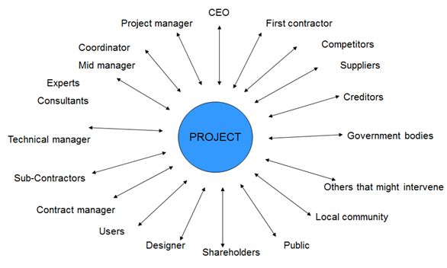
Project Stakeholders
“Project stakeholders are individuals and organisations who are actively involved in the project, or whose interests may be positively or negatively affected as a result of project execution or successful project completion”.
Project stakeholders

Slide 23
The reasons for the success or failure of projects.
Why do projects fail?
Failure to align projects with organizational objectives
Poor scope
Unrealistic expectations
Lack of executive sponsorship
Lack of project management
Inability to move beyond individual and personality conflicts
Politics
Why do projects succeed?
Project sponsorship at executive level
Good project charter
Strong project management
The right mix of team players
Good decision making structure
Good communications
Team members are working toward common goals

Slide 24
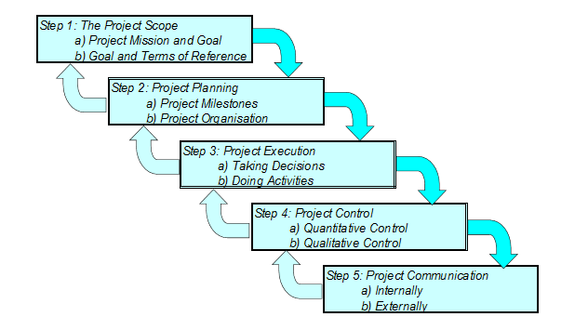
The Waterfall Model Concept
How to prepare a Project

Slide 25
II. Classification of project
Based on the following fundamentals:
* Strategy
Long term (Years)
Broad Goals (A company’s large scale objectives. I.E; Improve ROI, Increase Shareholder value, Gain market share etc…)
Setting global business or strategic goals such as your release criteria, workflow setup and lifecycle?
Selecting and assigning which resources are allocated to which projects (What team resources can I allocate? What can I afford to dedicate to this project?)
* Tactics
Short term (Months)
Specific Objectives (Hitting Milestones and Release Dates)
Micromanaging the day to day goals and activities, focusing on execution.
People: Assigning individuals or teams with domain expertise to specific actions.
The projects can be classified as:
* Strategic project
A strategic project has a primary goal of gaining the competitive advantage by focusing on the organization's overall direction.
* Tactical project
These are projects that have one operational goal, which probably does not entail contributions by most employees within the organization. In these projects, meeting a tactical goal on time and within budget are key considerations.

Slide 26
There are the different basis to classify the projects. Projects can be classified as under:
A. According to the source of fund
1. Private sector project
The private sector bodies are responsible for the development and sponsor of the project. Examples- RB complex, Kathmandu mall, Apartments etc.`
2. Government sector project
In developing country government is the major sponsor of projects. These are the basis of government developing plans. Examples- Road construction, school, health etc.
3. Grant project
Investment in grant projects is not repaid by the government to the donor agencies.
4. Loan project
Investment in loan projects is repaid by the government to the donor agencies.
– ADB USTH – project – Building of Hoa Lac compus for USTH.

Slide 27
There are the different basis to classify the projects. Projects can be classified as under:
B. According to foreign aided project
1. Joint venture project
The project is funded through the collaboration of foreign and local investors. They are based on ownership sharing. Also, they involve transferring of capital, technology, management. Example- Maruti-Suzuki.
2. Bilateral project
The project is funded from the financial resources of the friendly donor country. Examples- JICA, KOICA.
Viet Nam – France University.
3. Multilateral project
This project is funded from the financial resources of multilateral agencies such as World Bank and Asian development bank. They are generally funded through loans. All UN agencies are multilateral.

Slide 28
There are the different basis to classify the projects. Projects can be classified as under:
C. According to Techniques
1. Labor intensive project
This project is labor based. Human labors are extensively used for implementation of the project.
Advantages
More employment generation.
Utilization of resources.
More production at the cheaper rate.
Disadvantages
It cannot be applied for the long run.
No possibility of improving skills.
Low capital formation.

Slide 29
There are the different basis to classify the projects. Projects can be classified as under:
C. According to Techniques
2. Capital Intensive Project
This project is technology based. Technology represented by machinery and computerization is extensively used for implementation of the project.
Advantages
Applied for the long run.
Technology transfer.
Ease in capital formation.
Disadvantages
Required huge amount of capital.
Imbalance distribution of income in society.
Centralization.

Slide 30
There are the different basis to classify the projects. Projects can be classified as under:
D. According to function
1. Disaster prevention projects.
It is not feasible to formulateuniversally acceptable definition of disaster prevention project thet will satisfy all practioners, but common and agreed upon definitions must be formulated in the various fields and areas concerned with disasters and where there exit reconcizable, common sets of objective.
Example: Disaster prevention project for sustainable project.

Slide 31
There are the different basis to classify the projects. Projects can be classified as under:
D. According to function
2. Development project
Community Development project
* Abstract
The development objective of the Community Development Project is to establish an effective and sustainable instrument to improve the living conditions and the economic status of disadvantaged communities. There are two main project components. The first focuses on social and infrastructure development and provides sub-project grants for:

Slide 32
There are the different basis to classify the projects. Projects can be classified as under:
D. According to function
2. Development project
1) carrying out social assessments and designing programs of sub-projects; and
2) implementing sub-projects consisting of:
a) improving access to basic education, health, and social services by rehabilitating and upgrading schools and health, youth, cultural, and recreation centers and facilities in poor areas;
b) carrying out programs for revolving school textbooks, literacy, and primary health care;
c) improving access to specialized social services to satisfy the needs of vulnerable groups at risk;
d) developing basic rural infrastructure activities such as community potable water and small drainage and irrigation schemes; and
e) enhancing environmental protection initiatives such as reforestation and natural resource and cultural heritage preservation.
The second component focuses on income enhancement by funding capacity building activities to support:
1) micro and small entrepreneurs and nongovernmental organizations providing credit to target beneficiary groups; and
2) women, youth, and disabled people to provide them with demand-driven specialized skills that will help them increase income and business opportunities

Slide 33
There are the different basis to classify the projects. Projects can be classified as under:
* Example
Official development assistance (ODA) is a term coined by the Development Assistance Committee (DAC) of the Organisation for Economic Co-operation and Development (OECD) to measure aid. The DAC first used the term in 1969. It is widely used as an indicator of international aid flow. It includes some loans.
Definition
The full definition of ODA is:
Flows of official financing administered with the promotion of the economic development and welfare of developing countries as the main objective, and which are concessional in character with a grant element of at least 25 percent (using a fixed 10 percent rate of discount). By convention, ODA flows comprise contributions of donor government agencies, at all levels, to developing countries (“bilateral ODA”) and to multilateral institutions. ODA receipts comprise disbursements by bilateral donors and multilateral institutions.

Slide 34
There are the different basis to classify the projects. Projects can be classified as under:
OECD, Glossary of Statistical Terms
In other words, ODA needs to contain the three elements:
  undertaken by the official sector (official agencies, including state and local governments, or their executive agencies)
  with promotion of economic development and welfare as the main objective; and
  at concessional financial terms (if a loan, having a grant element of at least 25 per cent).
This definition is used to exclude development aid from the two other categories of aid from DAC members:
Official Aid (OA): Flows which meet conditions of eligibility for inclusion in Official Development Assistance (ODA), other than the fact that the recipients are on Part II of the Development Assistance Committee (DAC) List of Aid Recipients.
Other Official Flows (OOF): Transactions by the official sector with countries on the List of Aid Recipients which do not meet the conditions for eligibility as Official Development Assistance or Official Aid, either because they are not primarily aimed at development, or because they have a grant element of less than 25 per cent.

Slide 35
There are the different basis to classify the projects. Projects can be classified as under:
NGOs project definition
A non-governmental organization (NGO) is a non-profit, citizen-based group that functions independently of government. NGOs, sometimes called civil societies, are organized on community, national and international levels to serve specific social or political purposes, and are cooperative, rather than commercial, in nature.
Examples of NGOs include those that support human rights, advocate for improved health or encourage political participation. Two broad groups of NGOs are identified by the World Bank: operational NGOs, which focus on development projects; and advocacy NGOs, which are organized to promote particular causes. Certain NGOs may fall under both categories simultaneously.
While the term "NGO" has various interpretations, it is generally accepted to include private organizations that operate without government control and that are non-profit and non-criminal. Other definitions further clarify NGOs as associations that are non-religious and non-military.
Some NGOs rely primarily on volunteers, while others support a paid staff. As non-profits, NGOs rely on a variety of sources for funding, including membership dues, private donations, the sale of goods and services, and grants. Despite their independence from government, some NGOs rely significantly on government funding.
Large NGOs may have budgets in the millions or billions of dollars.

Slide 36
There are the different basis to classify the projects. Projects can be classified as under:
Examples
If a donor country accords a grant or a concessional loan to Afghanistan it is classified as ODA, because it is on the Part I list.
If a donor country accords a grant or a concessional loan to Bahrain it is classified as OA, because it is on the Part II list.
If a donor country gives military assistance to any other country or territory it is classified as OOF, because it is not aimed at development.
A recent OECD DAC Commique has seen the donor community update the definition of ODA to better reflect the Sustainable Development Goals.

Slide 37
There are the different basis to classify the projects. Projects can be classified as under:
Countries by development aid given
ODA volumes may be measured absolutely, by the amount transferred, or relatively, as a proportion of the donor country's economy. According to the Organisation for Economic Co-operation and Development (OECD), the top 15 countries (DAC and non-DAC members) giving the highest amounts (in absolute terms) in 2015 are as follows:

Slide 38
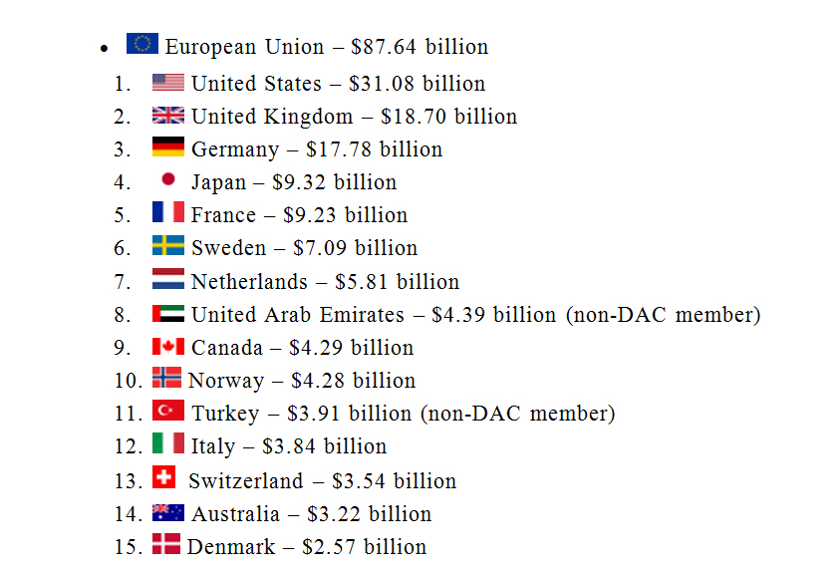
There are the different basis to classify the projects. Projects can be classified as under:
Countries by development aid given

Slide 39
There are the different basis to classify the projects. Projects can be classified as under:
Donor countries by percentage of gross national income
The OECD also lists countries by the amount of ODA they give as a percentage of their gross national income. Seven countries met the longstanding UN target for an ODA/GNI ratio of 0.7% in 2015. The top 15 DAC and non-DAC countries for 2015 are shown below:

Slide 40
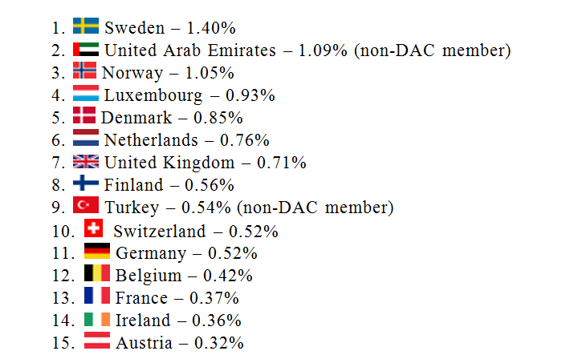
There are the different basis to classify the projects. Projects can be classified as under:
Donor countries by percentage of gross national income
The average for European Union countries that are DAC members – 0.47%

Slide 41
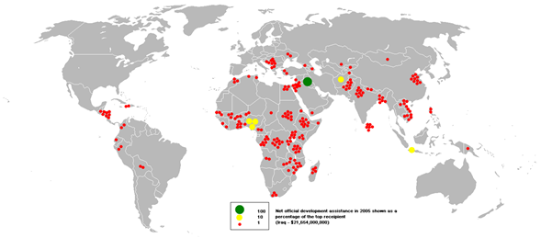
There are the different basis to classify the projects. Projects can be classified as under:
Aid recipients
The average for European Union countries that are DAC members – 0.47%

Slide 42
There are the different basis to classify the projects. Projects can be classified as under:
Aid recipients
World Bank reports that Iraq was the top recipient of development aid in 2005 followed by Nigeria. However, this is due to the significant debt relief deals that were granted to these nations that year - when donor countries write off a portion of a recipient country's debt, it is counted as official development assistance from the donor country.
The OECD reports that in 2009 Africa received the largest amount of ODA, at $28 billion. Of that, $25 billion went to countries south of the Sahara, with Sudan receiving approximately $1.9 billion and Ethiopia getting $1.8 billion. Asia received the second largest amount at $24 billion. The top ODA receiving countries in order were Afghanistan ($5.1 billion), Iraq ($2.6 billion) and Vietnam ($2.1 billion)

Slide 43
There are the different basis to classify the projects. Projects can be classified as under:
Criticism
Official development assistance has been criticized by several economists for being an inappropriate way of helping poor countries. The Hungarian economist Peter Thomas Bauer has been one of the most vocal of them. Another notable economist arguing against ODA includes Dambisa Moyo in her book Dead Aid. According to her, a country used to receiving ODA may be perpetually bound to depend on handouts.
Donor countries are most commonly compared by the amount of Official Development Assistance given and their quantity of aid as a percent of GDP. However, there is an increasing focus placed on the quality of aid, rather than simply the quantity. The Commitment to Development Index is one such measure that ranks the largest donors on a broad range of their "development friendly" policies. It takes into account the quality of aid, in addition to the quantity, penalizing countries for tied aid. Aid also does not operate in a vacuum; a country's policies on issues such as trade or migration also have a significant impact on developing countries.

Slide 44
There are the different basis to classify the projects. Projects can be classified as under:
3. Service sector project
Agricultural Services Sector Project
The Agricultural Services Sector Project addresses two main goals of the Government's new agricultural sector policy: improvement of cost-effectiveness of public expenditures in the agricultural sector and improvement of nutritional standards and incomes in rural areas. The project is a hybrid operation composed of a policy component and an investment component. The policy component focuses on:
(1) reforming the agricultural input policy;
(2) reorganization of Buyenzi and Kirimiro Regional Development Companies (RDC); and
(3) reforming the salary structure of the Ministry of Agriculture and Livestock (MOAL) staff.
The investment component comprises:
(1) strengthening of MOAL's central services;
(2) strengthening agricultural research;
(3) strengthening through reorganization of regional agricultural services;
(4) management of RDC reorganization;
(5) promotion of community development and rural youth employment; and
(6) strengthening of the cooperative movement.

Slide 45
There are the different basis to classify the projects. Projects can be classified as under:
4. Scientific research project (chapter IV).
Application of Scientific method to the investigation of relationships among natural phenomenon to solve a technical problem.
5. Environment-friendly projects.
Green - chemistry (chapter IV).

Slide 46
There are the different basis to classify the projects. Projects can be classified as under:
E. According to scale and size
1. Mega project
A project involving huge investment and of relatively long duration (5 to 10 years) is called mega project. These projects require EIA. Example- Upper Karnali hydropower project.
2. Major project
It is smaller in size and also less complex than the mega project. Example- Middle Marshyangdi hydropower project.
3. Medium project
It is small in size than the major project. Examples- Khimti hydropower project. This project requires IEE (Initial Environmental Examination).
4. Small project
It is the smallest project in size and also of short duration. Example- Manang hydropower.
5. Micro project
It is smaller than the small project and managed by community-based organizations. Example - Ghandruk micro hydropower project.

Slide 47
There are the different basis to classify the projects. Projects can be classified as under:
F. According to time frame and speed
1. Normal project
Normal time allowed for project implementation.
2. Crash project
Saving in time is achieved by spending extra resources in terms of money, materials and manpower.

Slide 48
There are the different basis to classify the projects. Projects can be classified as under:
G. According to nature
1. Simple project
Simple projects involve only one or a few people over a short time. Typically, simple projects will have few tasks dependent on other tasks, and will be relatively straightforward and easy to coordinate. Examples might be coordinating delivery of resources for a workshop session, implementing a small marketing plan, or delivering a simple software enhancement.
2. Complex project
Nearly all large and many small projects exhibit characteristics of complexity. Nevertheless projects of all sizes continue to be managed using linear thinking strategies based on project management traditions that go back to the building of the great pyramids in Egypt during the third millennium BCE, when societies and workgroups were arranged hierarchically. Much of the thinking dominating project management as it is currently practiced and taught is still founded upon control theories which were developed in the early modern period to deal with nineteenth- and twentieth-century industrialization and imperial expansion. There is nothing intrinsically wrong with this. However, issues do arise when these ideas are applied unilaterally to all kinds of projects in all contexts.

Slide 49
There are the different basis to classify the projects. Projects can be classified as under:
G. According to nature
3. Innovative
Innovation is often also viewed as the application of better solutions that meet new requirements, unarticulated needs, or existing market needs. This is accomplished through more-effective products, processes, services, technologies, or business models that are readily available to markets, governments and society. The term "innovation" can be defined as something original and more effective and, as a consequence, new, that "breaks into" the market or society. It is related to, but not the same as, invention. Innovation is often manifested via the engineering process. The opposite of innovation is exnovation.
While a novel device is often described as an innovation, in economics, management science, and other fields of practice and analysis, innovation is generally considered to be the result of a process that brings together various novel ideas in a way that they affect society. In industrial economics, innovations are created and found empirically from services to meet the growing consumer demand.
4. Emergency
Emergency project is the work the organization and management of resources and responsibilities for dealing with all humanitarian aspects of emergencies – preparedness, response, and recovery – in order to reduce the harmful effects of all hazards, including disasters.

Slide 50
There are the different basis to classify the projects. Projects can be classified as under:
H. According to orientation
1. Product oriented project
The focus is on the technical part of the project. Examples-building, road, hydropower.
2. Process oriented
No consideration is given to technical part. Examples- person focused training, repair of cement plant etc.

Slide 51
III. Notable project examples
1. University for Science and Technology of Ha Noi (USTH)
The Bilateral project for Education and Training based on Intergovermental Agreement between Viet Nam and France:
“Establishment and Development of University for Science and Technology of Ha Noi”

Slide 52

III. Notable project examples

Slide 53
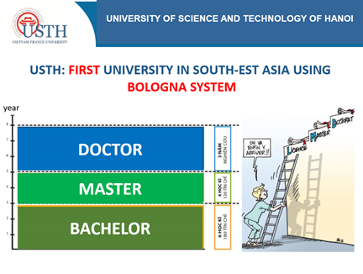
III. Notable project examples

Slide 54

III. Notable project examples

Slide 55
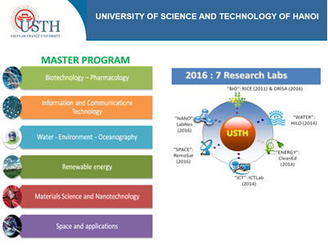
III. Notable project examples

Slide 56
III. Notable project examples
2. Loan project ADB–
BASIC DATA
Project Title: University of Science and Technology of Hanoi Development (New Model University) Project Borrower: the Government of Vietnam Executing Agency: Ministry of Education and Training Implementing agency: PMU-USTH and UIU Total Estimated Project Cost: US$213.0 M Financing Plan: OCR: US$ 170.0M ADFHT: US$ 20.0M Government Fund: US$ 23.0M | Loan Number: 2750/2751-VIE Loan Approval Date: 25 April 2011 Loan Agreement Signing Date: 10 November 2011 Loan Effectiveness: 1st March 2012 Original Loan Closing Date: 30 June 2018 Revised Loan Closing Date: None Elapsed Loan Period: 54 months Date of last ADB Review Mission: 19 – 27 Oct 2015

Slide 57
III. Notable project examples
2. Loan project ADB–
BASIC DATA
The ADB agreed to provide a loan of $170 million from ADB’s ordinary capital resources (OCR) and a loan of $20 million from the hard terms facility of the Asian Development Fund (ADFHT) to finance the project. The OCR loan will have a 26-year term, including a grace period of 6 years, an annual interest rate determined in accordance with ADB’s London interbank offered rate (LIBOR)-based lending facility,a commitment charge of 0.15% per annum on any undisbursed amount of the loan, and such other terms and conditions as set forth in the draft loan agreement. The ADFHT loan will have a 32-year term, including a grace period of 8 years, an interest rate of 2.02% per annum throughout the life of the loan, and such other terms and conditions as set forth in the draft loan agreement. The Government committed to allocate $20 million as counterpart fund to cover Project operation and taxes and duties, plus $3 million for resettlement and land acquisition costs.

Slide 58
III. Notable project examples
2. Loan project ADB–
BASIC DATA
Output A: Effective Management and Governance System for the USTH.
Output A will assist in the development and implementation of the rigorous management and governance systems, capacity building programs for USTH senior managers and governors, university management and administrative systems and student services.
Output B: Systems to Promote High Quality and Relevance in Academic Programs at USTH Developed and Implemented.
Output 2 will establish and support the operation of a number of centers within the USTH that will promote high quality and relevance in academic programs at the USTH:

Slide 59
III. Notable project examples
2. Loan project ADB–
BASIC DATA
Center for teaching and learning excellence. This will prepare graduate students to be university teachers and improve the teaching and curriculum development competencies of existing teachers.
Center for quality assurance. This will embed a permanent internal quality assurance management service for USTH management and academic staff by, among other things, establishing a quality assurance framework and institutionalizing the use of peer review and other strategies.
Center for research support. The center will provide USTH staff with high-level support in designing and publishing their research, applying for grants, and providing training in research strategies to postgraduate students.

Slide 60
III. Notable project examples
2. Loan project ADB–
BASIC DATA
Center for industry engagement. The center will be responsible for building links with industry and other potential users of USTH’s knowledge, expertise, and technologies. It will support researchers to establish industry links, develop joint research programs and contract research, and facilitate student placements, staff exchanges, and joint funding of infrastructure and services.
Center for laboratory management. The center will develop a centralized workshop system for the maintenance and repair of USTH’s scientific laboratories and build the capacity of technical staff to sustain an international standard science and technology university.

Slide 61
III. Notable project examples
2. Loan project ADB–
BASIC DATA
Output C: Physical Facilities at University of Science and Technology of Hanoi Constructed and Outfitted.
Output 3 will support the design, construction, and outfitting of the USTH physical facilities at the HHTP to support the university’s initial design capacity of 5,000 students. This will include site preparation, and design and construction of teaching spaces, research laboratories, dormitories, student leisure facilities, administration buildings, infrastructure, and provision of furniture, fittings, and equipment. Construction will use a design–bid–build approach.
Output D: Effective Project Management and Implementation.
Output 4 will support the establishment of systems and staff capacity required for effective project management and implementation. Procurement for the construction of the campus under output 3 will be managed by the central project management unit (PMU-USTH), while the university implementation unit (UIU) will manage the implementation of USTH’s development (Outputs 1 and 2). The PMU-USTH will manage the development and implementation of a project monitoring and evaluation system, including preparation of required plans, data systems, and baseline studies.

Slide 62
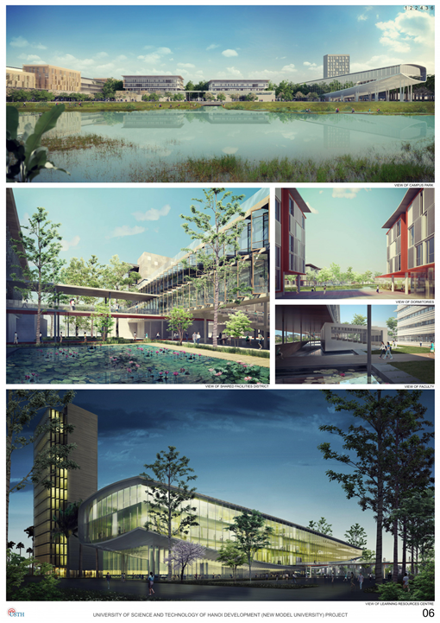

III. Notable project examples
Hoa Lac Campus

Slide 63
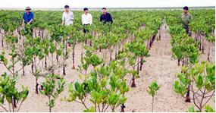
III. Notable project examples
3. Disaster Prevention Project in Vietnam
Disaster prevention through mangrove afforestation Contributing to protection of the Earth’s environment
Mangroves, which grow in marshy places, are called a ‘green wall’, protecting people from natural disasters such as typhoons and tsunami. The Japanese Red Cross Society (JRCS), has worked with the Vietnam Red Cross Society (VRCS), since 1997 to promote the afforestation of mangroves and other plants and on various environmental protection activities, covering about 10,408 hectares, which is equal to about 2226 Tokyo Domes. These forests are estimated to absorb about 16.3 million tons of greenhouse gas and thus contribute to the prevention of global warming.

Slide 64
III. Notable project examples
3. Disaster Prevention Project in Vietnam
Disaster prevention through mangrove afforestation Contributing to protection of the Earth’s environment
‘We have come to live safely.’‘Mangrove’ is the general term for various types of plants growing in brackish (a mixture of fresh and salt) water. Mangrove forests were once numerous in Vietnam due to its rich environment. But war, deforestation, and shrimp farming have reduced the number by half. As a result, damage due to typhoons and tidal conditions has grown year by year, gravely affecting the lives of local people and their crops.
A disaster prevention project promoting mangrove afforestation was launched by the JRCS and VRCS to address this problem. Afforestation is carried out by hand of local people, and a wide range of activities aimed at forest protection and fire prevention enlightenment by local volunteers have been undertaken.

Slide 65
III. Notable project examples
3. Disaster Prevention Project in Vietnam
Disaster prevention through mangrove afforestation Contributing to protection of the Earth’s environment
Hoan Ruon, vice chairman of the Red Cross branch in Hai Phong City, which is one of the project targets, looked back at the fruits of these activities over the past 20 years and said, ‘Although it has been very hard to attract volunteers, all of the members enthusiastically tackled their assignments. As a result, they have contributed to a reduction in climate change and the disasters it brings.’
Bui An Bien in Thai Binh province, who took part in the afforestation activities from the beginning of the project, said in joy, ‘Afforestation led to a safe life. Mangroves are a good environment for fish and other types of seafood, so we could start aquafarming.
Mangrove afforestation in Vietnam has been supported by the JRCS for 20 years. The initial target was six northern provinces. It has since been enlarged to ten provinces. The VRCS makes a strong effort to cooperate with the government to promote future support from the government.

Slide 66

Can Gio Mangrove biosphere reserve

Slide 67
Questions for Review
1-What is a project ?
2-which are characteristics of a project ?
3-The reasons for Project Failure and Success ?
3-How to classify the projects ?
-What is ODA ;NGOs ?
4-How to prepare a project ( how many steps are there ) ?
5-Give Project Examples ?
6- How do you understand the “ Term ” Project Stakeholders : CEO…

